Slide 1
N₂-filled MPC for pulse compression
Yi-Hao Chen

Slide 2
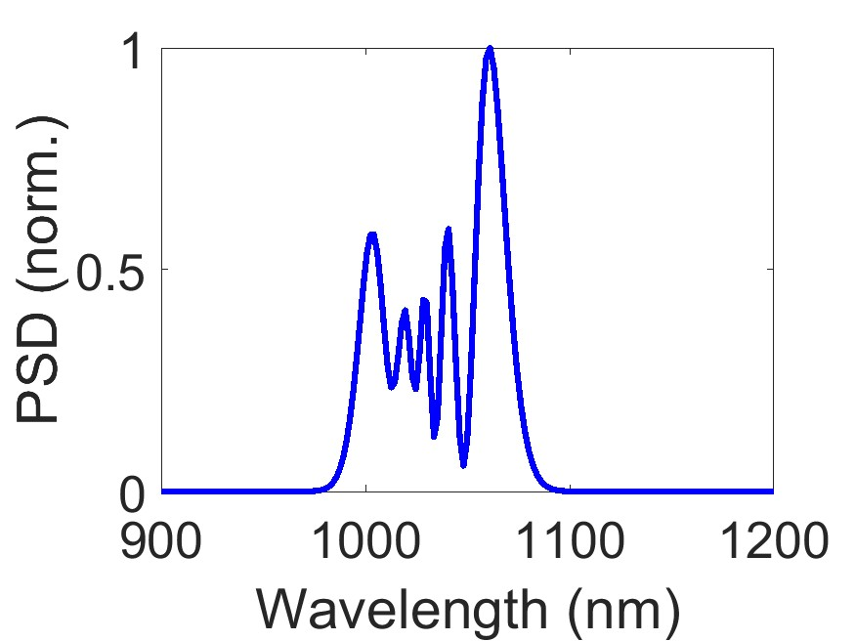
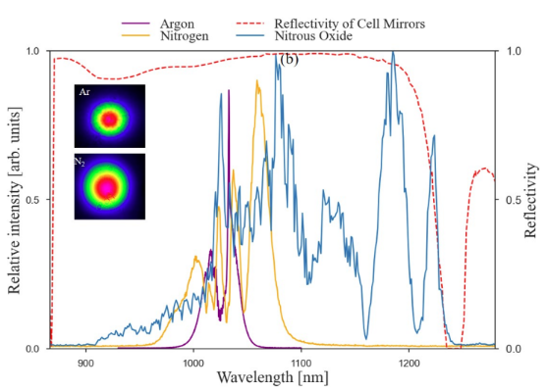
My simulation vs. paper experiment
Good consistency!
Simulation
Paper experiment (yellow line)

